Slide 1

Software

Slide 2
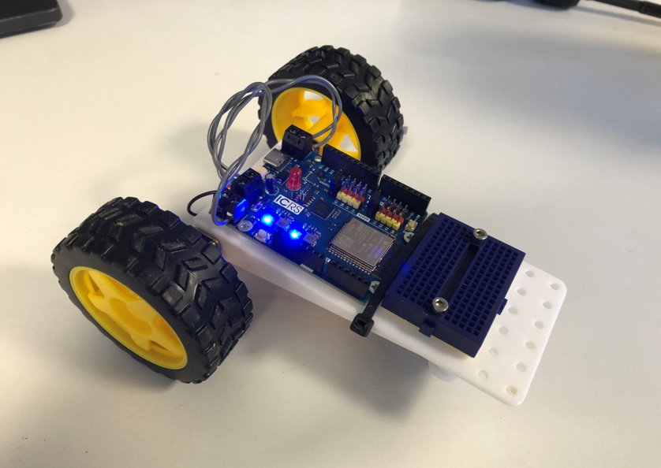
Goals
Introduction to Arduino
Basics of programming
Programming the 101 board
Finish the RC Car 🎉

Slide 3

Programming Microcontrollers
What is a microcontroller?
A small computer with at least one processor, memory and programmable IO.
Arduino IDE
Micro-Python
AVR-GCC + C
…

Slide 4


Arduino
Open-source electronics platform
Targets microcontrollers

Slide 5
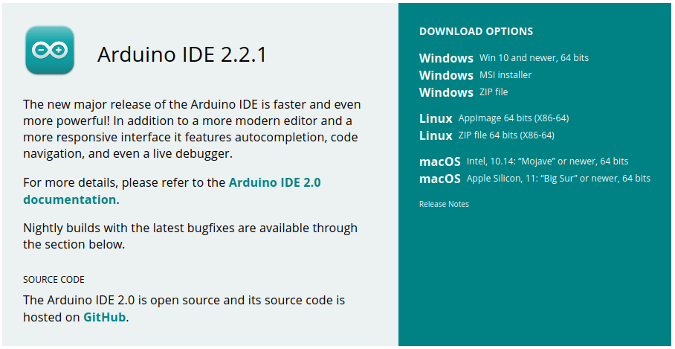
Arduino IDE Setup
https://www.arduino.cc/en/software

Slide 6
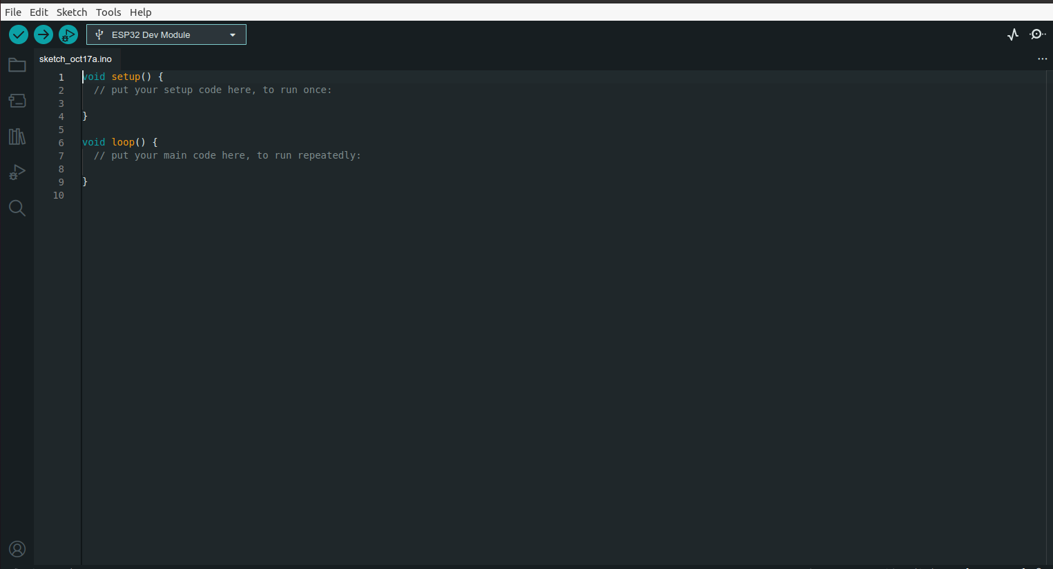

Slide 7
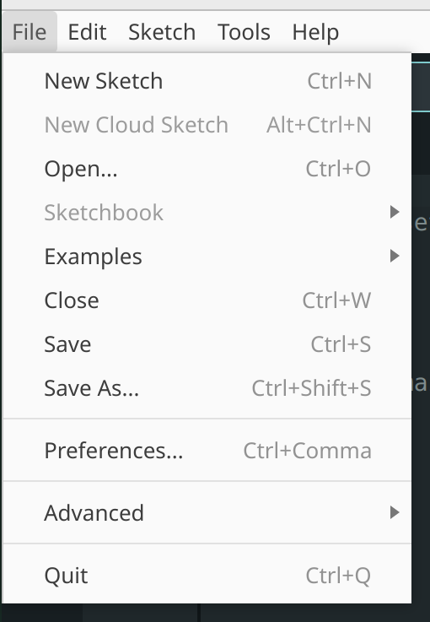
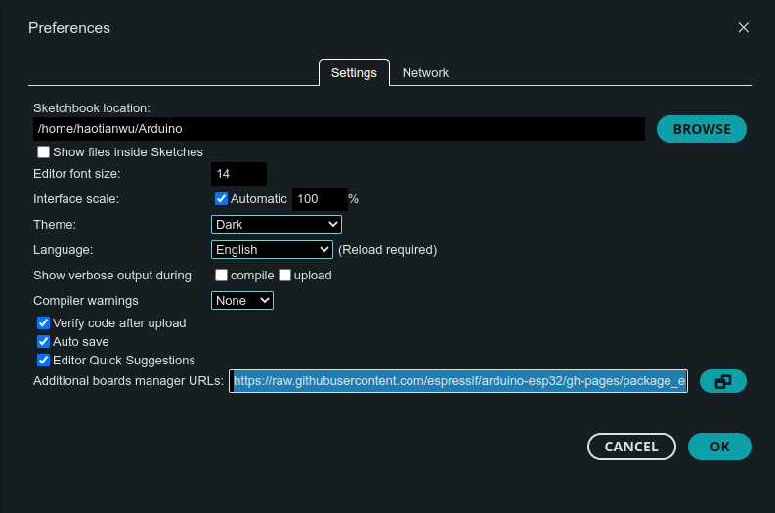
Arduino ESP32
https://raw.githubusercontent.com/espressif/arduino-esp32/gh-pages/package_esp32_index.json

Slide 8
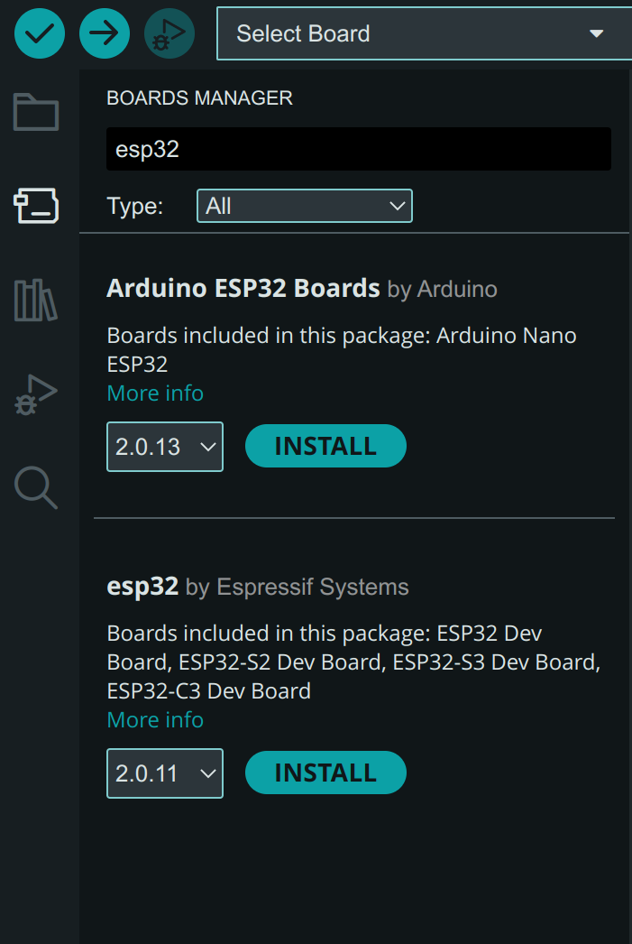
Add ESP32 Board

Slide 9
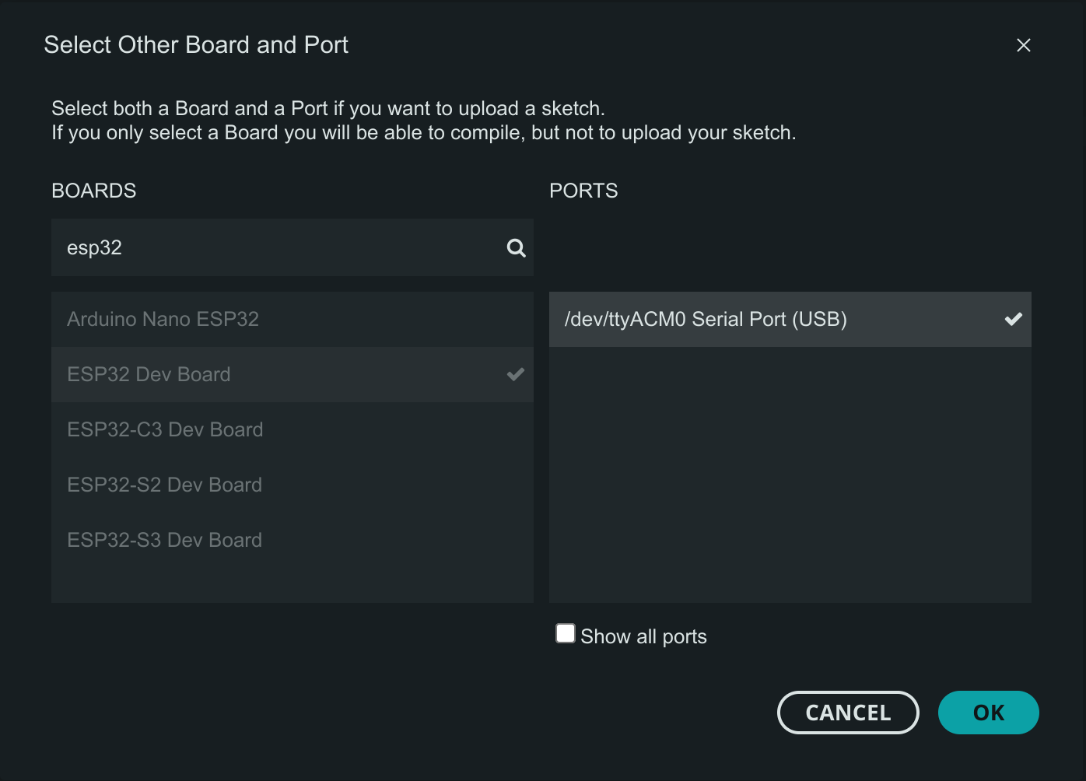

Slide 10
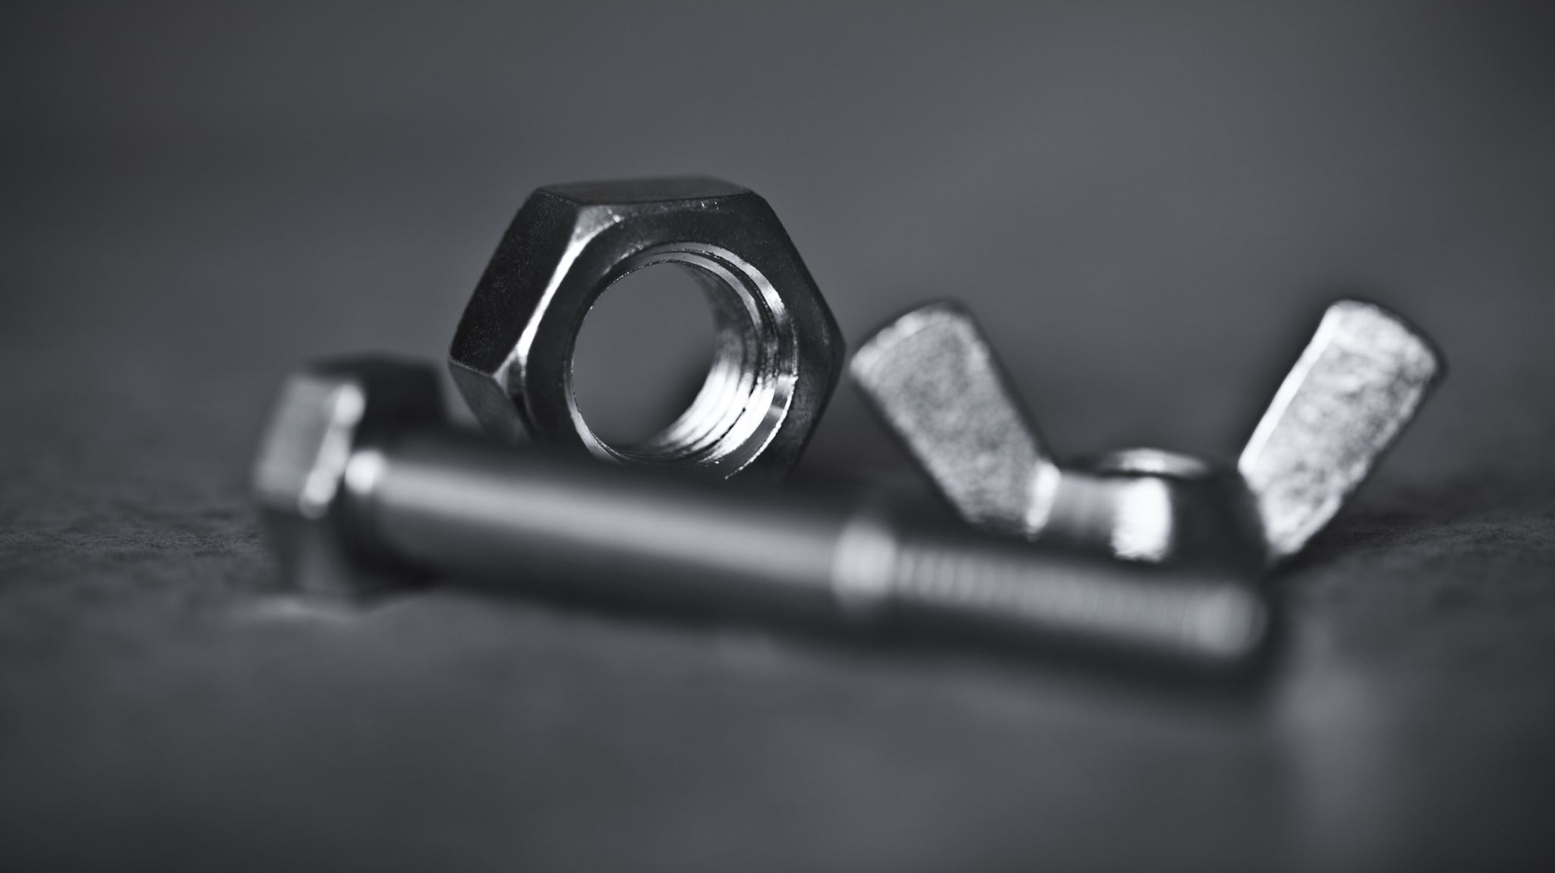
Hardware Recap

Slide 11
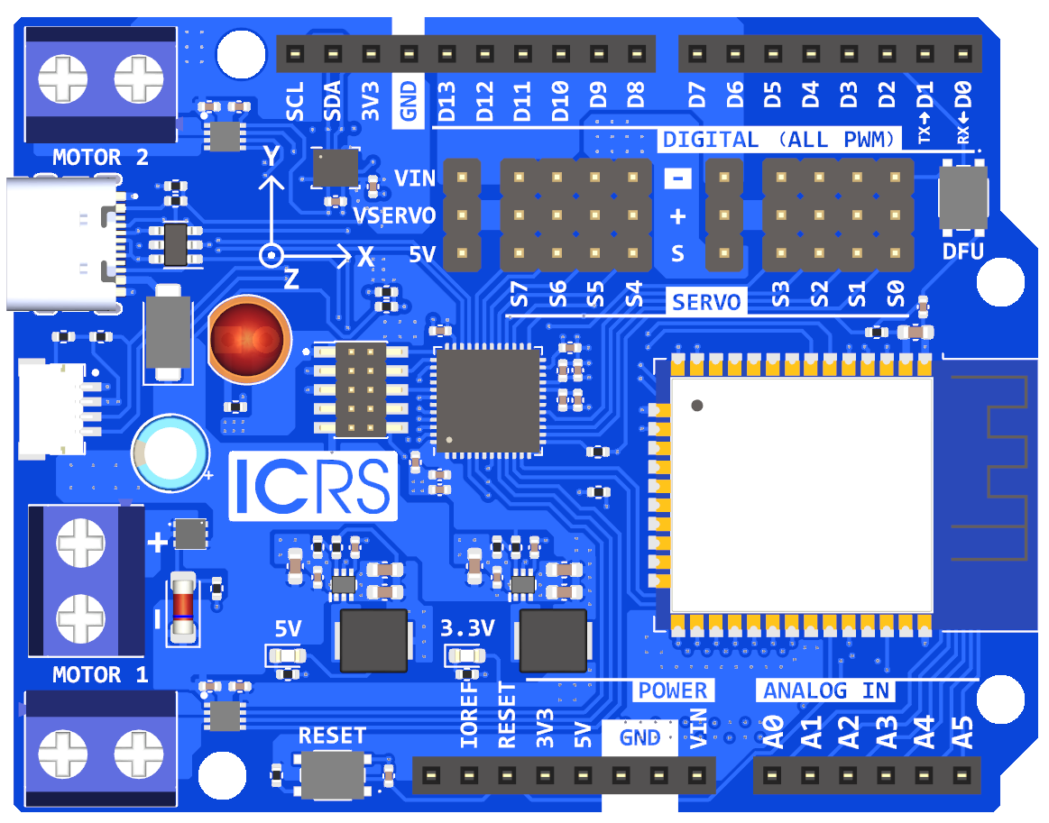
Features
Motor Out
GPIO Pins
Servo Pins
ESP 32
Power
Motor Out

Slide 12
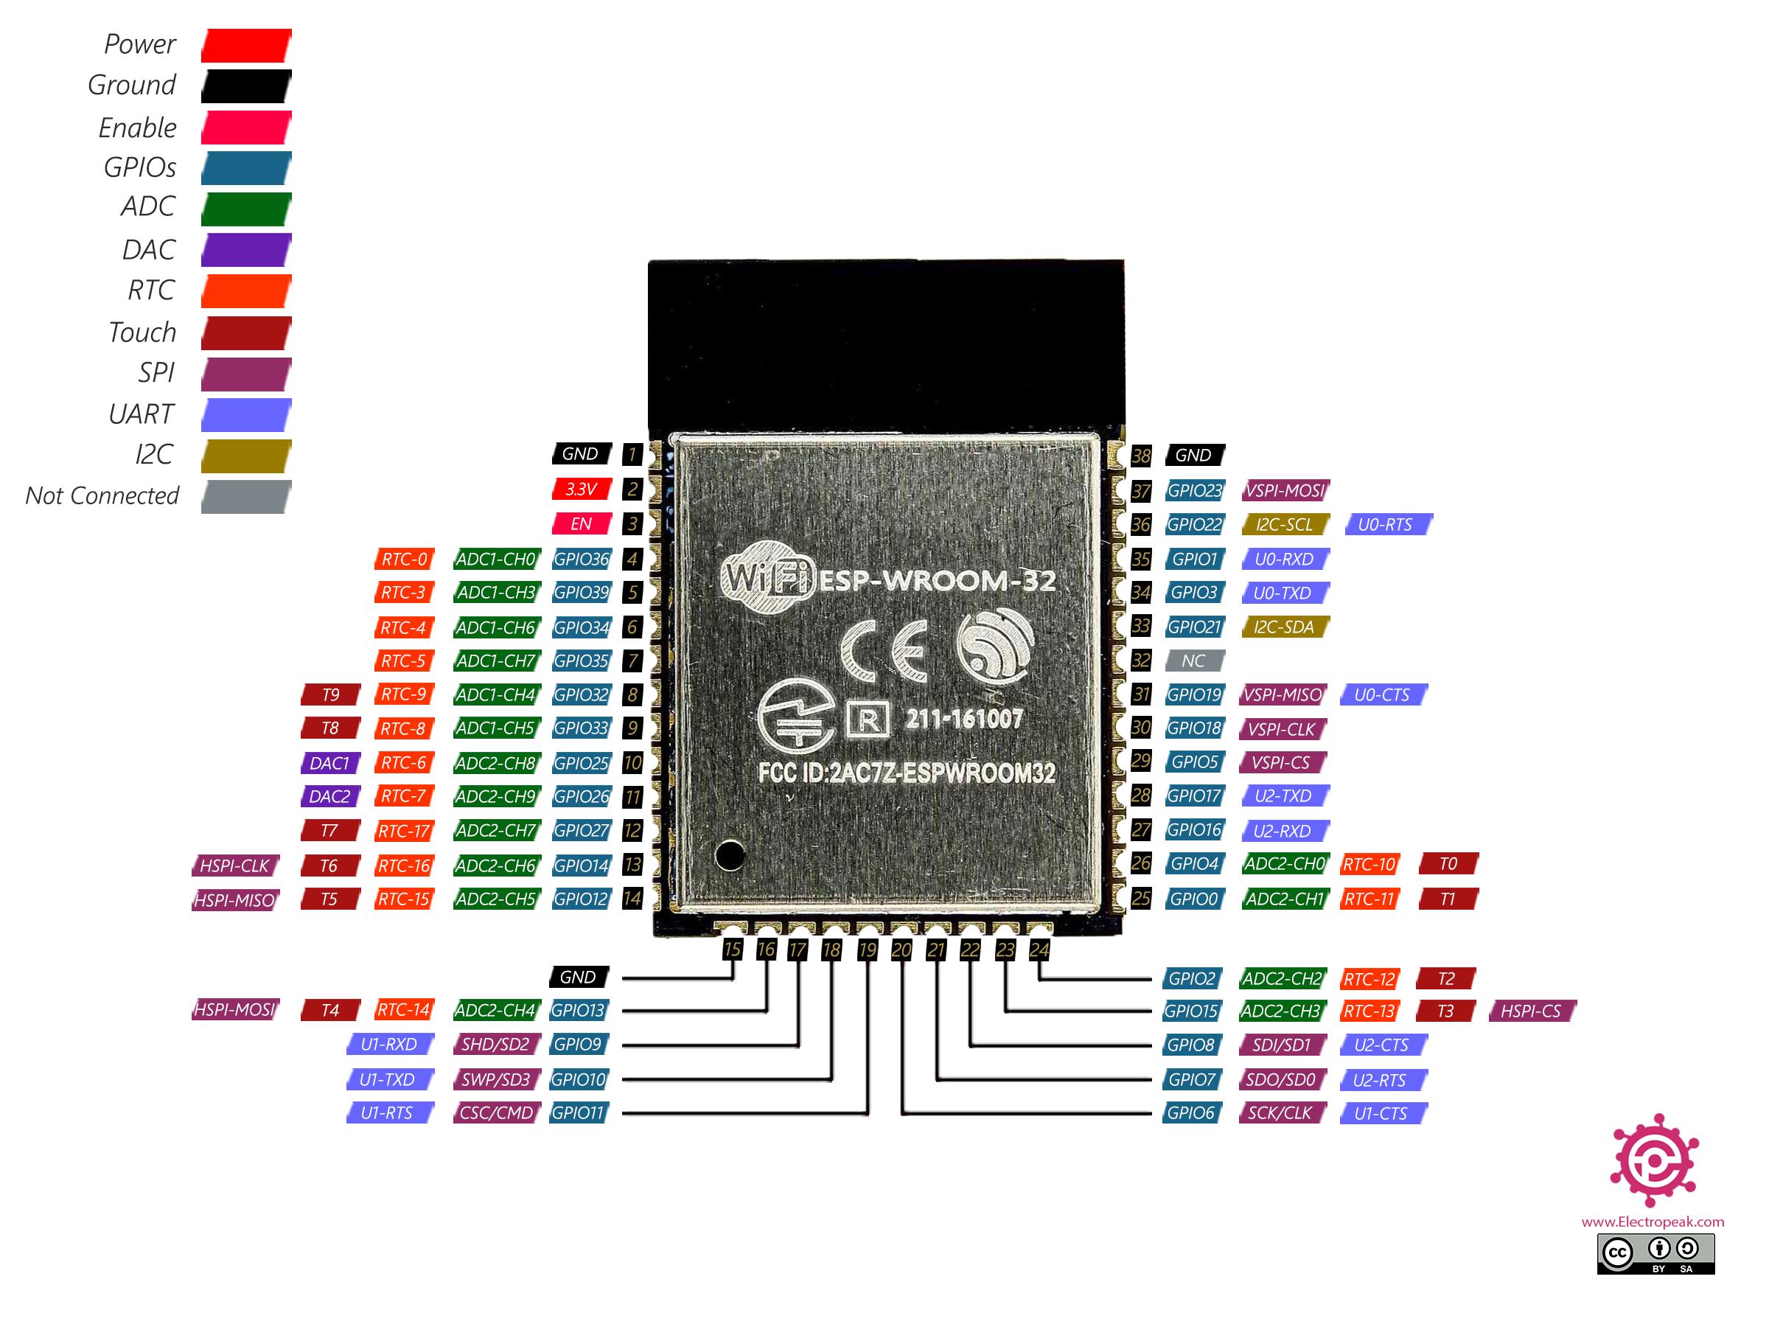
Advanced: ESP 32

Slide 13

Coding Time

Slide 14
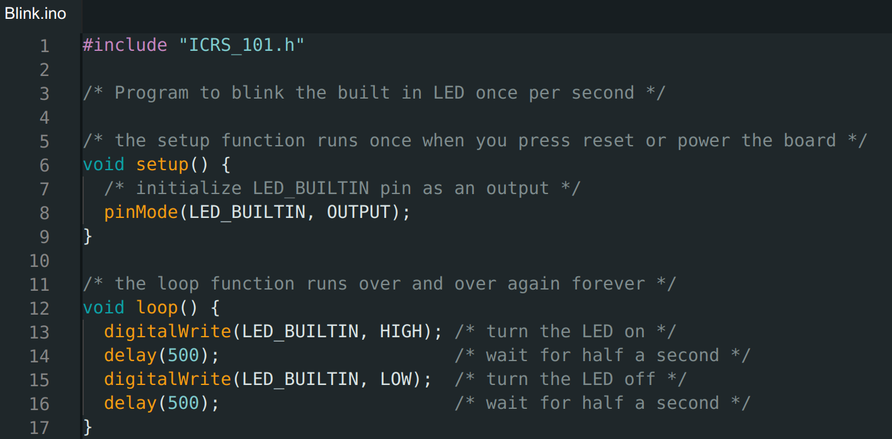
Print(“Hello World”)

Slide 15
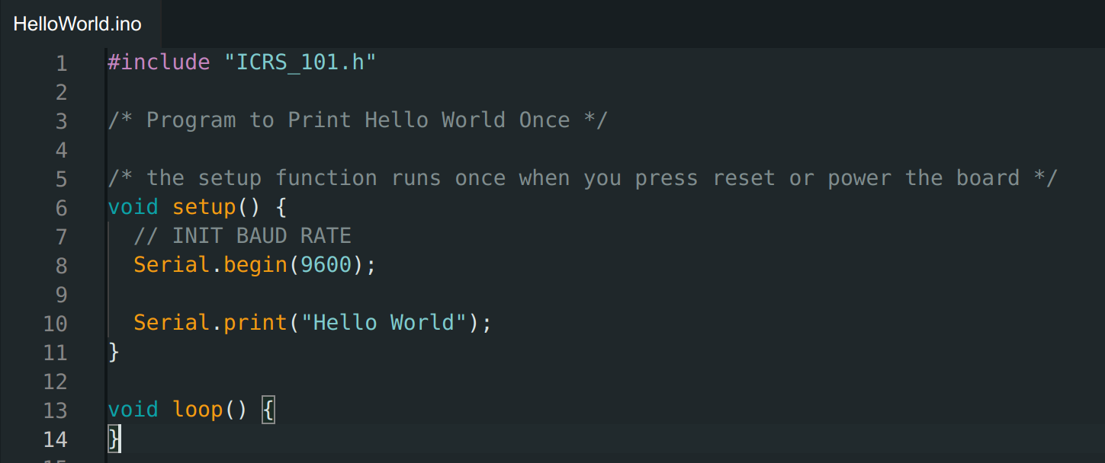
Serial Print ("Hello World")

Slide 16
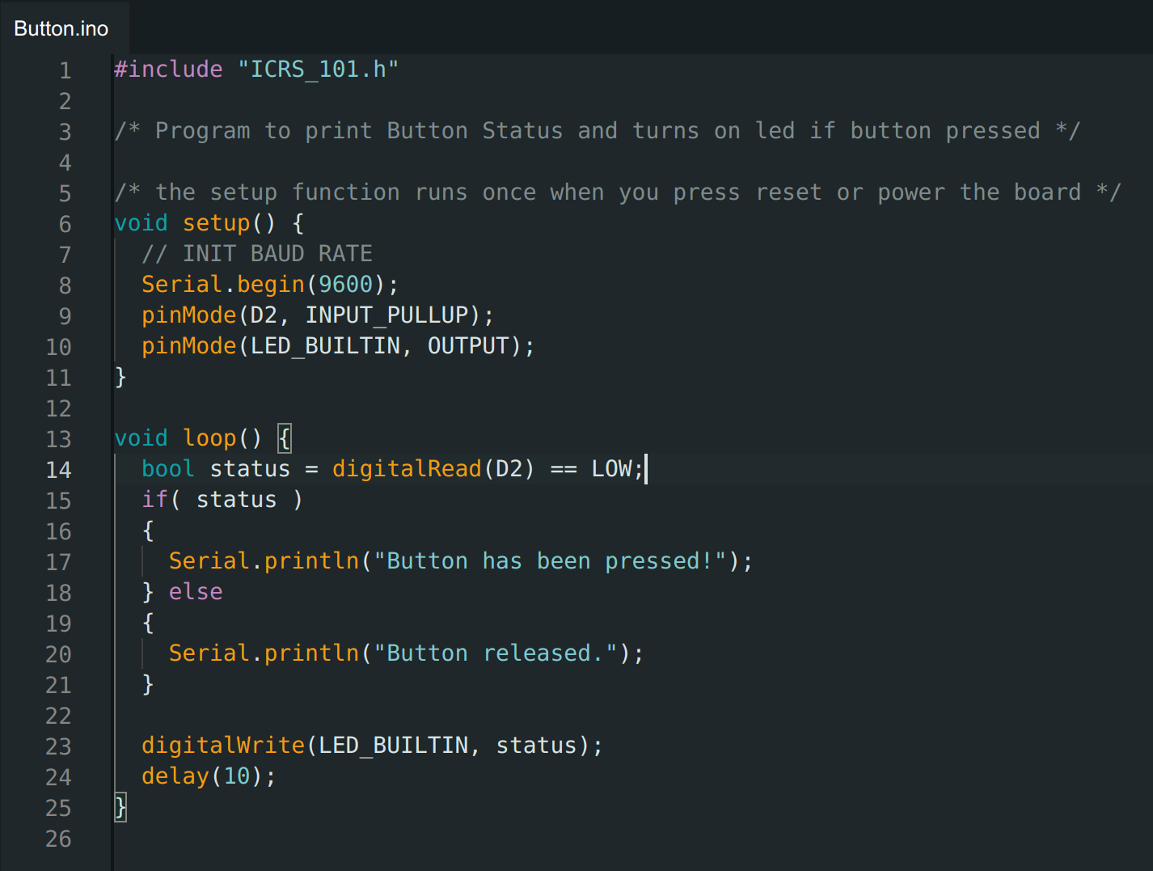
Digital IO

Slide 17
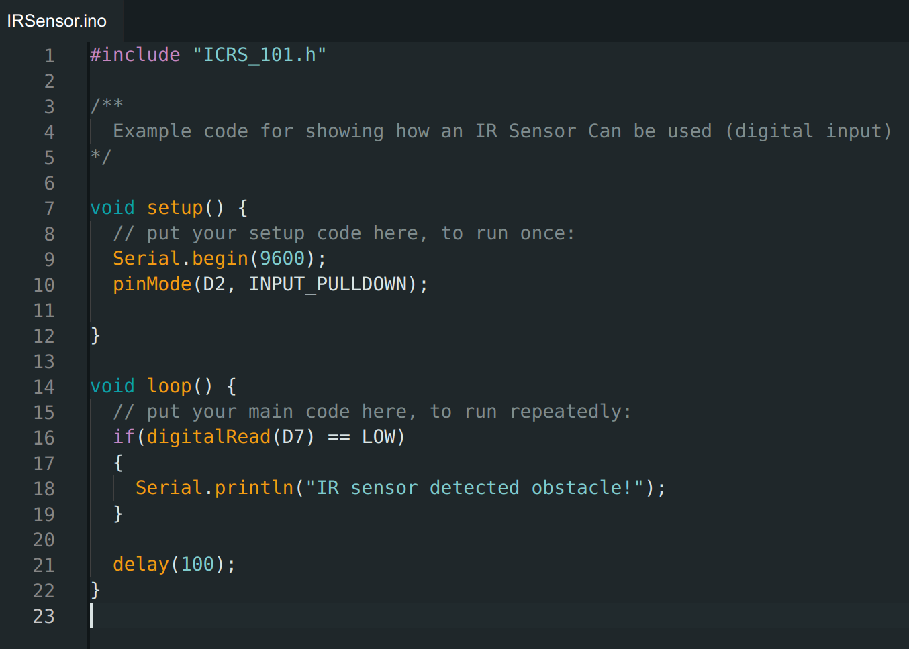
IR Sensor

Slide 18
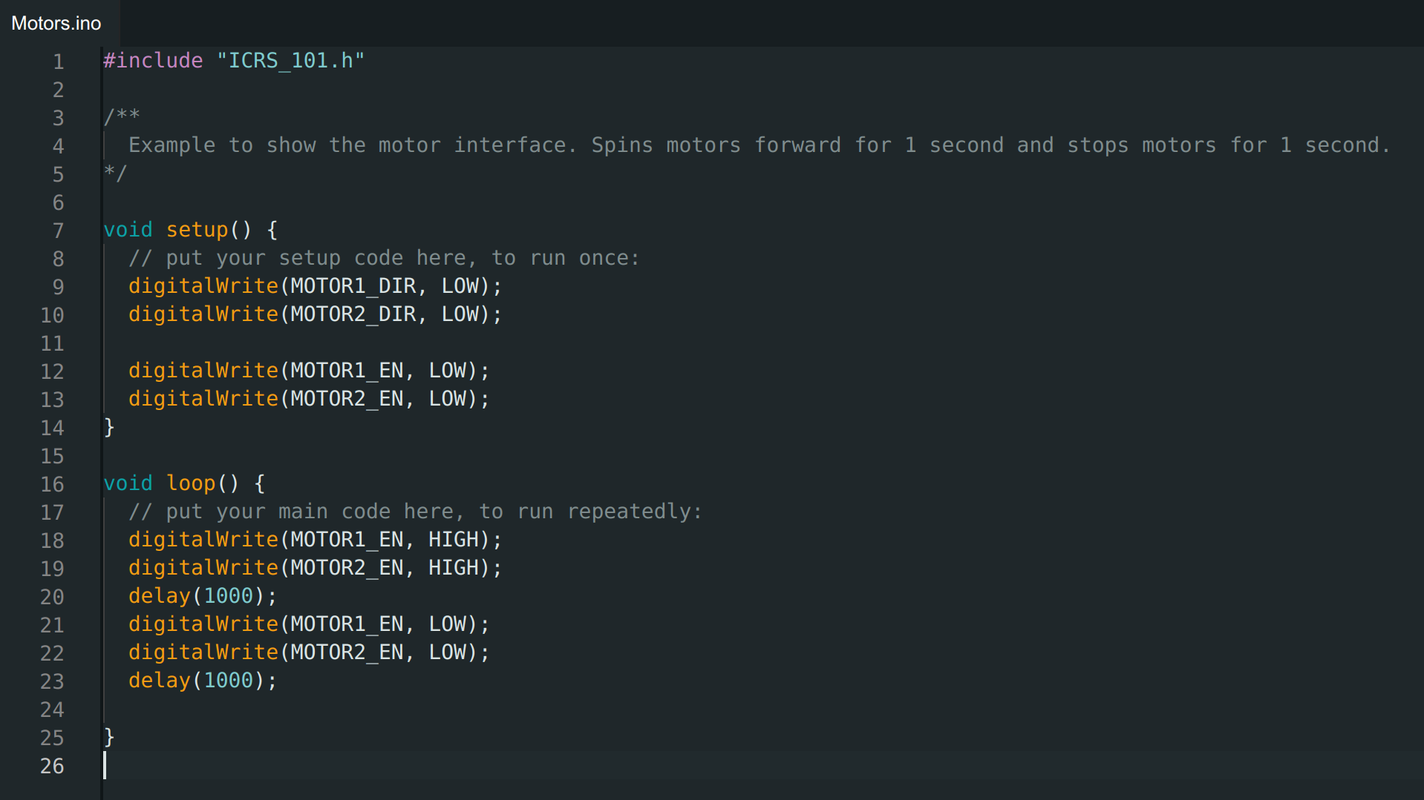
Motors

Slide 19
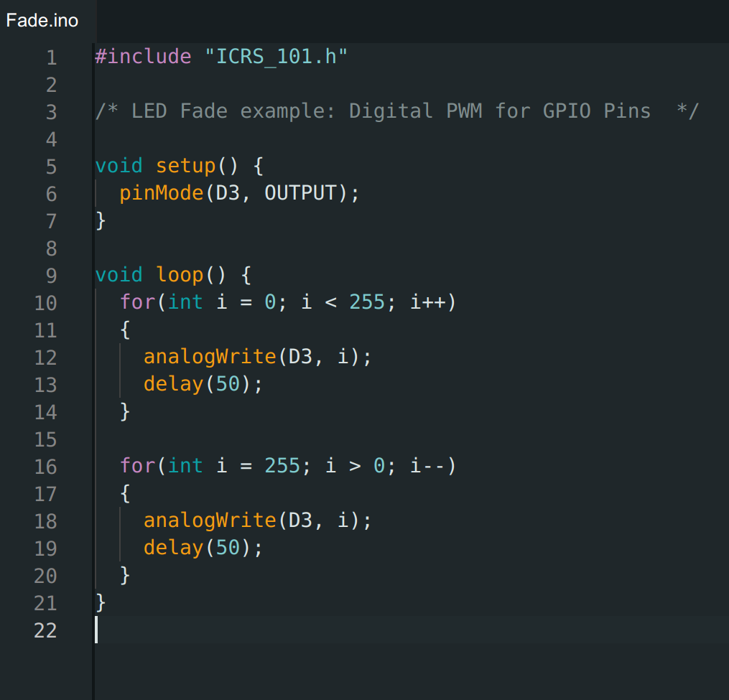
Analog GPIO

Slide 20

PWM Arduino

Slide 21
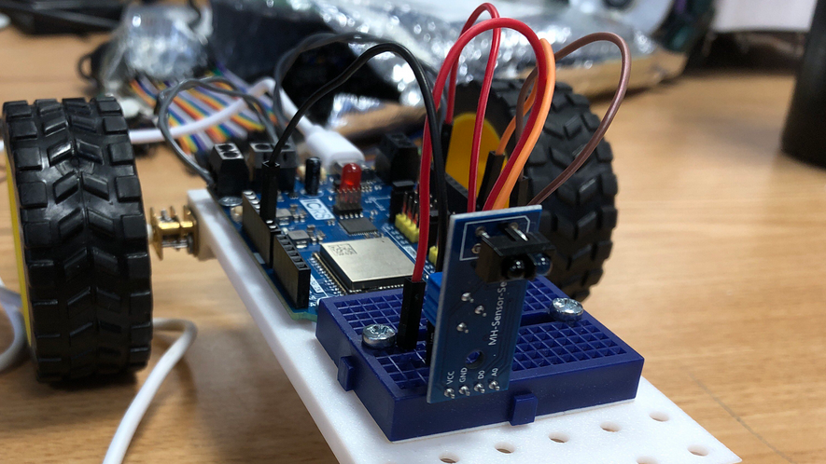
Putting Everything Together

Slide 22
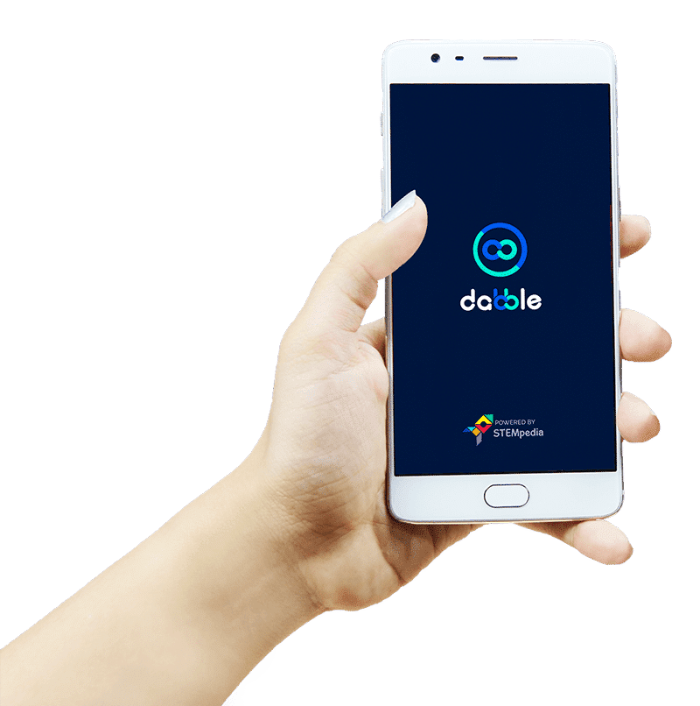
Dabble
https://thestempedia.com/product/dabble/

Slide 23
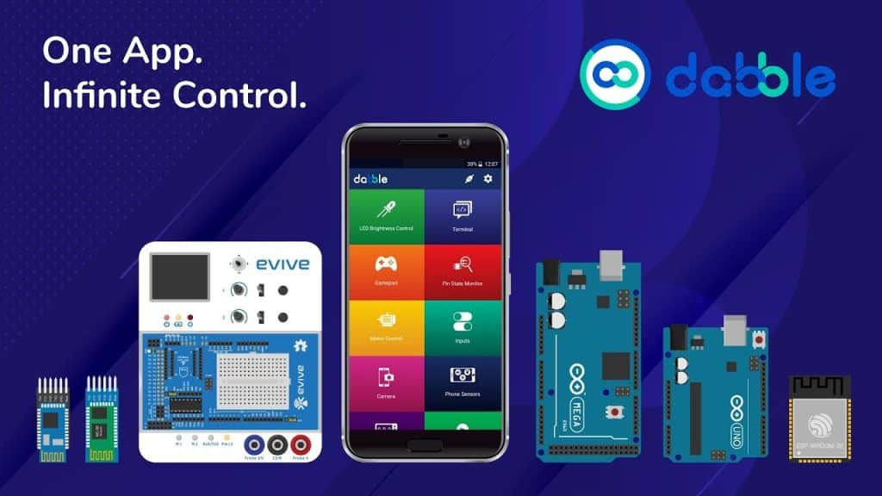
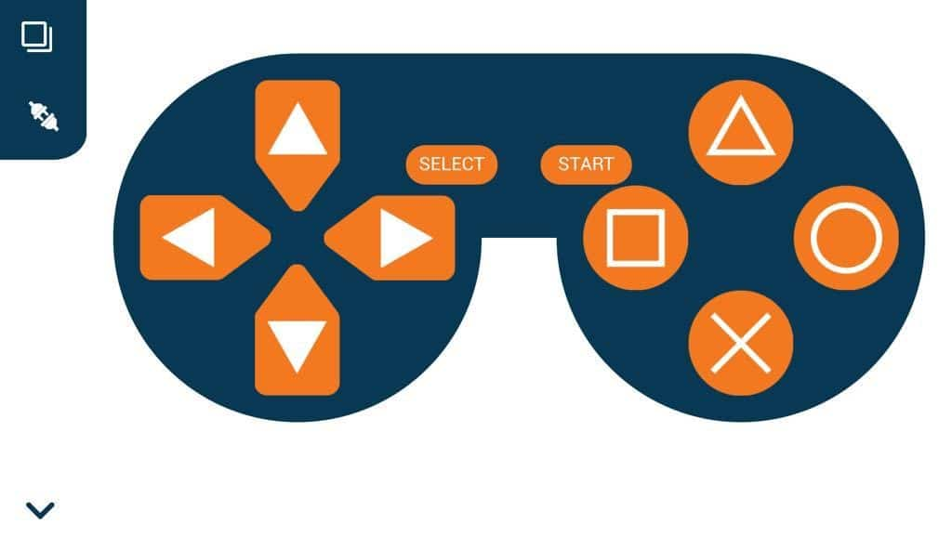

Slide 24


Install Dabble
https://thestempedia.com/product/dabble/​

Slide 25
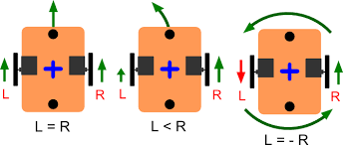

Slide 26
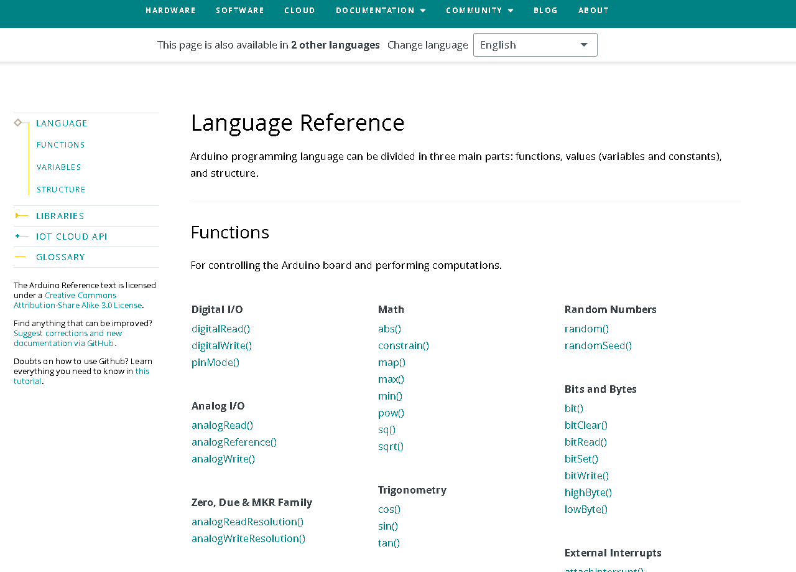
Arduino reference
https://www.arduino.cc/reference/en/

Slide 27

Code

